Slide 1
Initialization Tests
27Sep23 Meeting
Updated: 4/5/2023

Slide 2
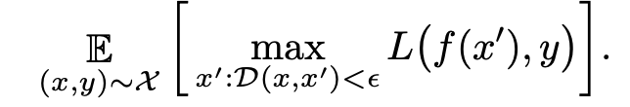
Adversarial Basics
Good Starting Point: https://arxiv.org/pdf/1902.06705.pdf
White Box (Full knowledge) and Black Box (limited knowledge)
Transferabilitly Principle: Adversarial examples often transfer between models. Transfer attack should be less successful than White Box.
Games: Adversarial training can be thought of as a game where attacker seeks to maximize the loss function while the defender minimizes.
Norm-based defense/attacks: Based on the min-max formulation used to defend against adversarial attacks, existing defenses are optimized for a particular ||.||_{p}
Most common is the max norm representing the maximum perturbation invisible to the human eye.
Screening/Preprocessing Defenses: Seeks to either filter anomalous inputs prior to classification (potentially unacceptable false positive rate) or pre-process to remove noise
Gradient Masking: Adversarial defense methodology results in no useful gradients, defeated by training adversarial examples on a substitute model (black-box attacks perform better than white box) https://dl.acm.org/doi/abs/10.1145/3052973.3053009

Slide 3


Attack Methodologies
Carlini and Wagner (C&W)
https://ieeexplore.ieee.org/document/7958570
Tsipras et al (PGD) (current implementation)
https://hdl.handle.net/1721.1/137496
(Maybe) Hard Label Attacks
The Boundary Attack performs a descent along the decision boundary using a rejection sampling approach.
Classic game formulation
Iterative attack within the eps inf-norm ball
Requires parameter tuning
Acknowledges non-concavity of the attacker’s problem and non-convexity of the defenders problem, paper randomly perturbs with the eps ball before conducting PGD and shows the local maxima have similar loss function values
Considered as strong of an attack as possible, but requires some knowledge of the target network
C&W identified issues with the projection with the projection step which I am still working through
Works for any particular p-norm
Targeted attack
Works on the logits from the model
Binary search to identify c
Random perturbation initialization to avoid local minima
Still uses PGD for differentiable norms, individual workaround for other norms
(Maybe) Gradient Free
https://arxiv.org/pdf/1708.03999.pdf
ZOO numerically estimates gradients and then performs gradient descent, making it powerful but potentially ineffective when the loss surface is difficult to optimize over.
Notes:
PGD currently implemented. Still needs parameter tuning and I need to work through the ’clipping’ issues to see if they apply. Will apply C&W for L2 and L-inf at least. Will/Currently have performed transfer attacks so may cut gradient free and hard label attacks based on group input and page constraints (would take more introduction/lit review, implementation, and computation space from any theoretical results)

Slide 4
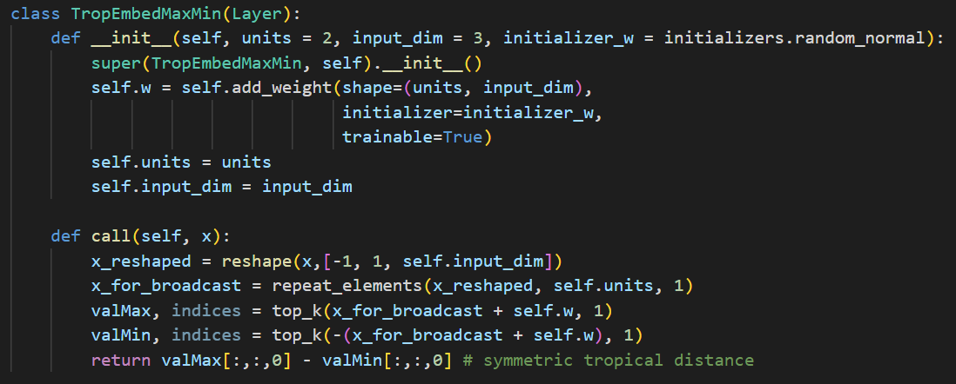
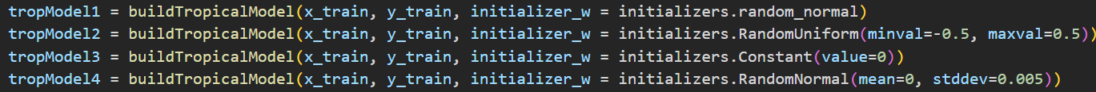
Experiment Details
Because weight initialization appears important, we added input argument to the TropEmbed layer to specify the initialization parameter for testing. We looked at 4 for initial tests:
The standard “random_normal” tensorflow input
U(0, 1)
0.5 vector [0, 0, …, 0]
N(0.5, 0.005)
Basic procedure. Gather pre/post, loss/accuracy data for many tests by doing the following:
Shuffle data
Build models w/ different initializations
Attack test set using PGD attack
Evaluate pre/post, test loss and accuracy
Record performance
Notes on some of the controlled parameters.
Data = CIFAR-10 data for horse and boat images
Tropical layer size = 100 neurons
Number of epochs = 10
Projected Gradient Descent attack parameters are specified to the right

Slide 5
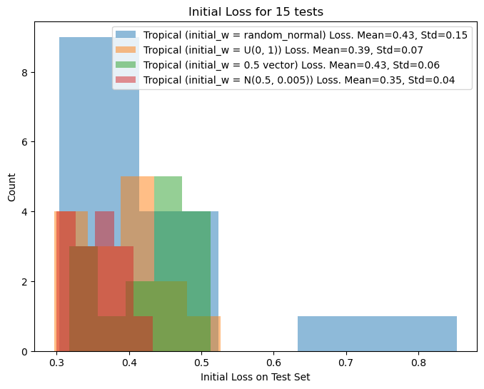
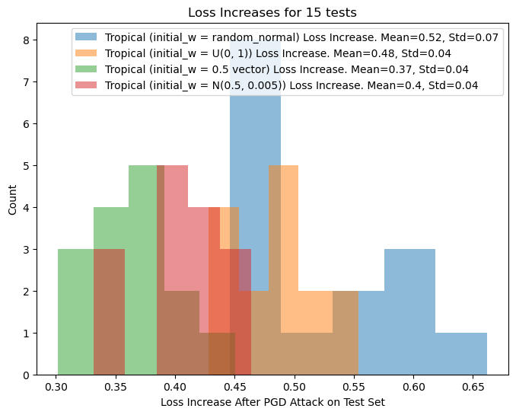
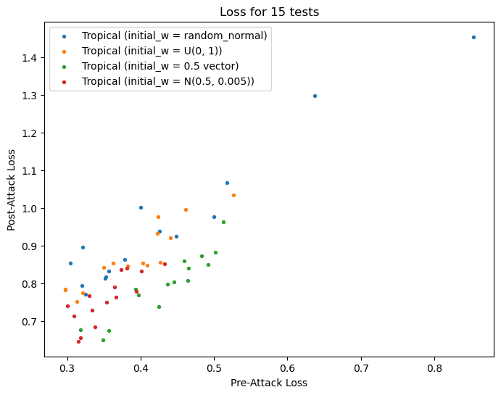
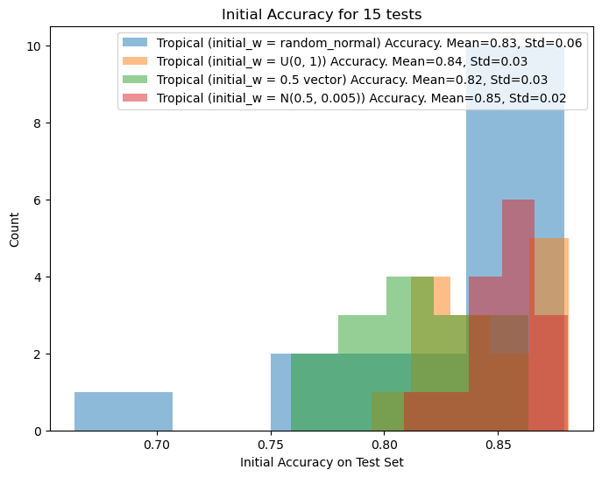
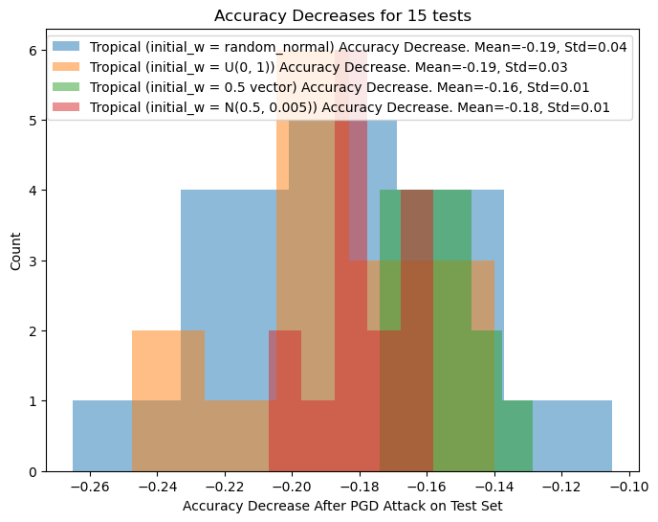
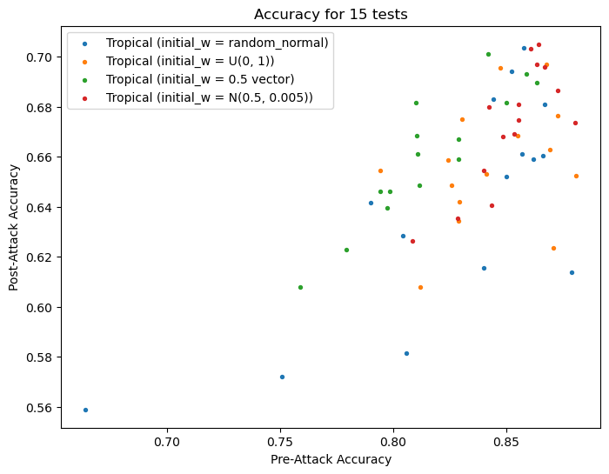
Model Performance on Test Set
Initial Loss/Accuracy
Increase in Loss/Accuracy from Attack
Pre/Post Attck Loss/Accuracy

Slide 6
Computational Way Forward
0) Work out weight initialization
1) Find convergence in PGD parameters
2) Apply to multi-classification and, ideally ImageNet with transfer learning
*3) Implement a gradient-free atack https://dl.acm.org/doi/pdf/10.1145/3052973.3053009
4) Implement other norms/non-pgd attacks: https://arxiv.org/pdf/1709.04114.pdf L-1, Carlini and Wagner
5) Define parameters for defense claim: This methodology defends against what type of attacks?
6) Establish lower bound: This methodology guarantees (proof or computationally) what lower bound on robustness?
7) Define an effective attack: What is the most effective attack against this network? This will take a good amount of theory.
*8) Other non-image data types audio, language, etc

Slide 7
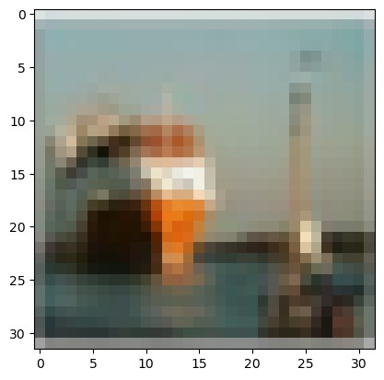

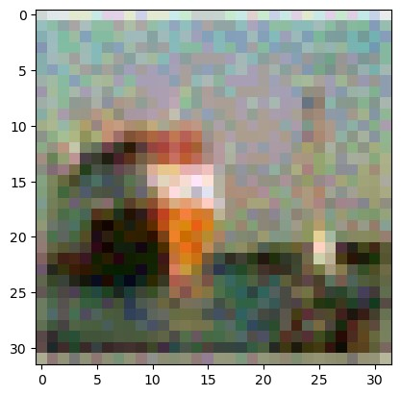
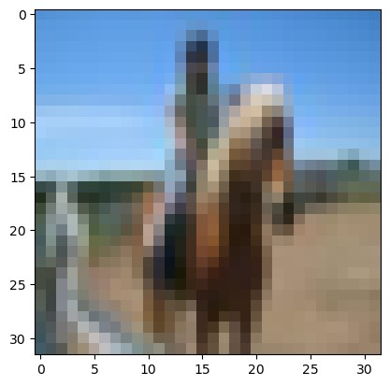

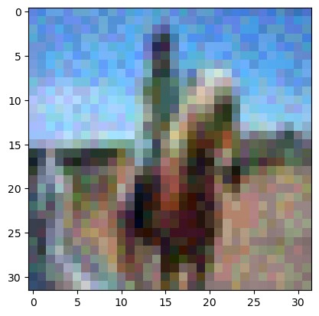
Example of epsilon = 0.05
Untouched Image
PGD w/ Tropical models
PGD w/ ReLu models

Slide 8
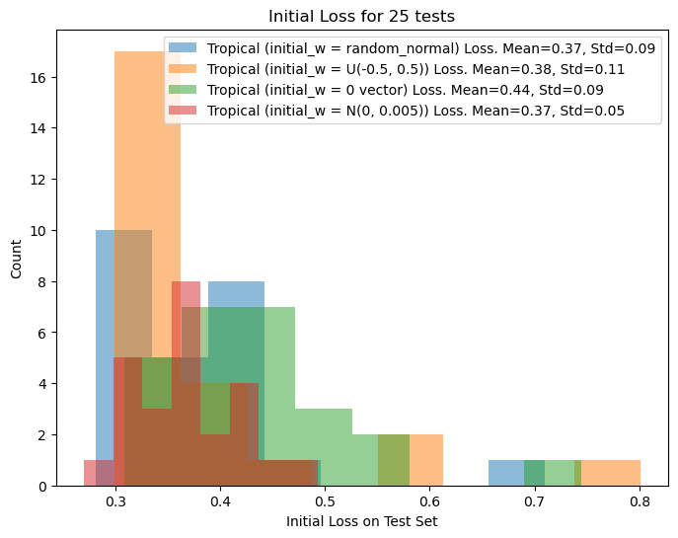
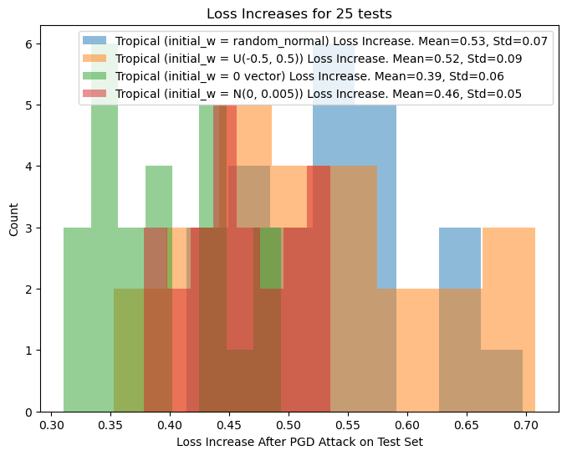
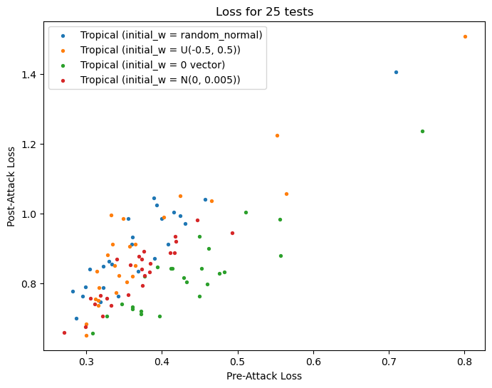
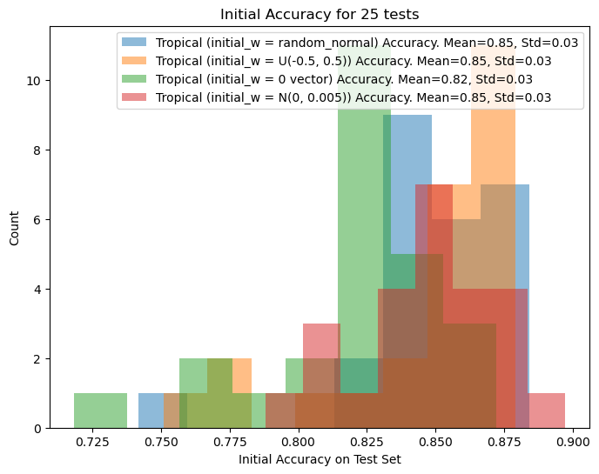
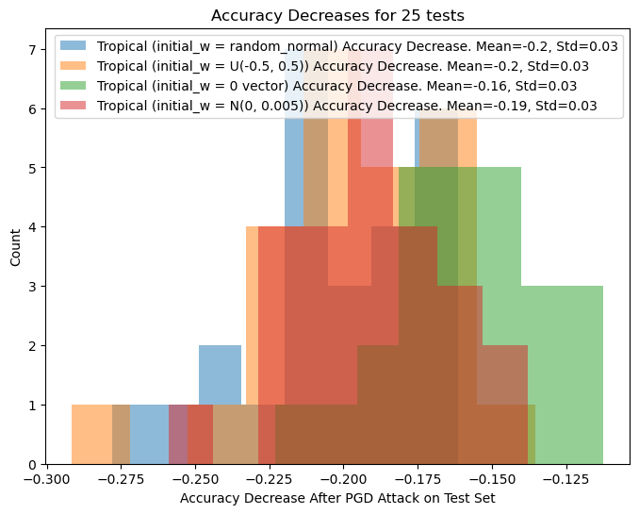
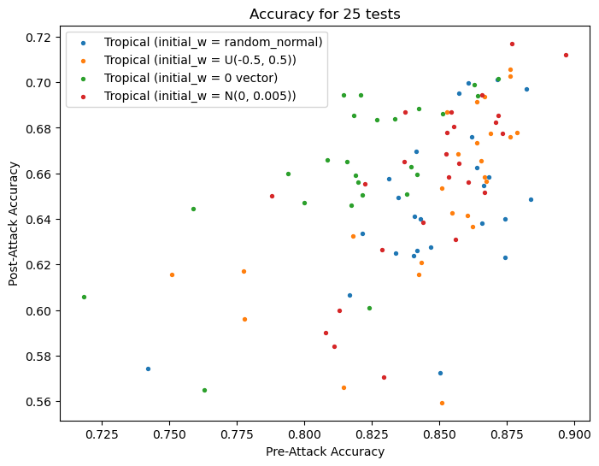
Model Performance on Test Set
Initial Loss/Accuracy
Increase in Loss/Accuracy from Attack
Pre/Post Attck Loss/Accuracy

